Slide 1
Headline: Telecom Customer Churn Prediction Pipeline Sub-headline: Retention Strategies for Prepaid Subscribers in East Africa
Name:
Registration number:

Slide 2
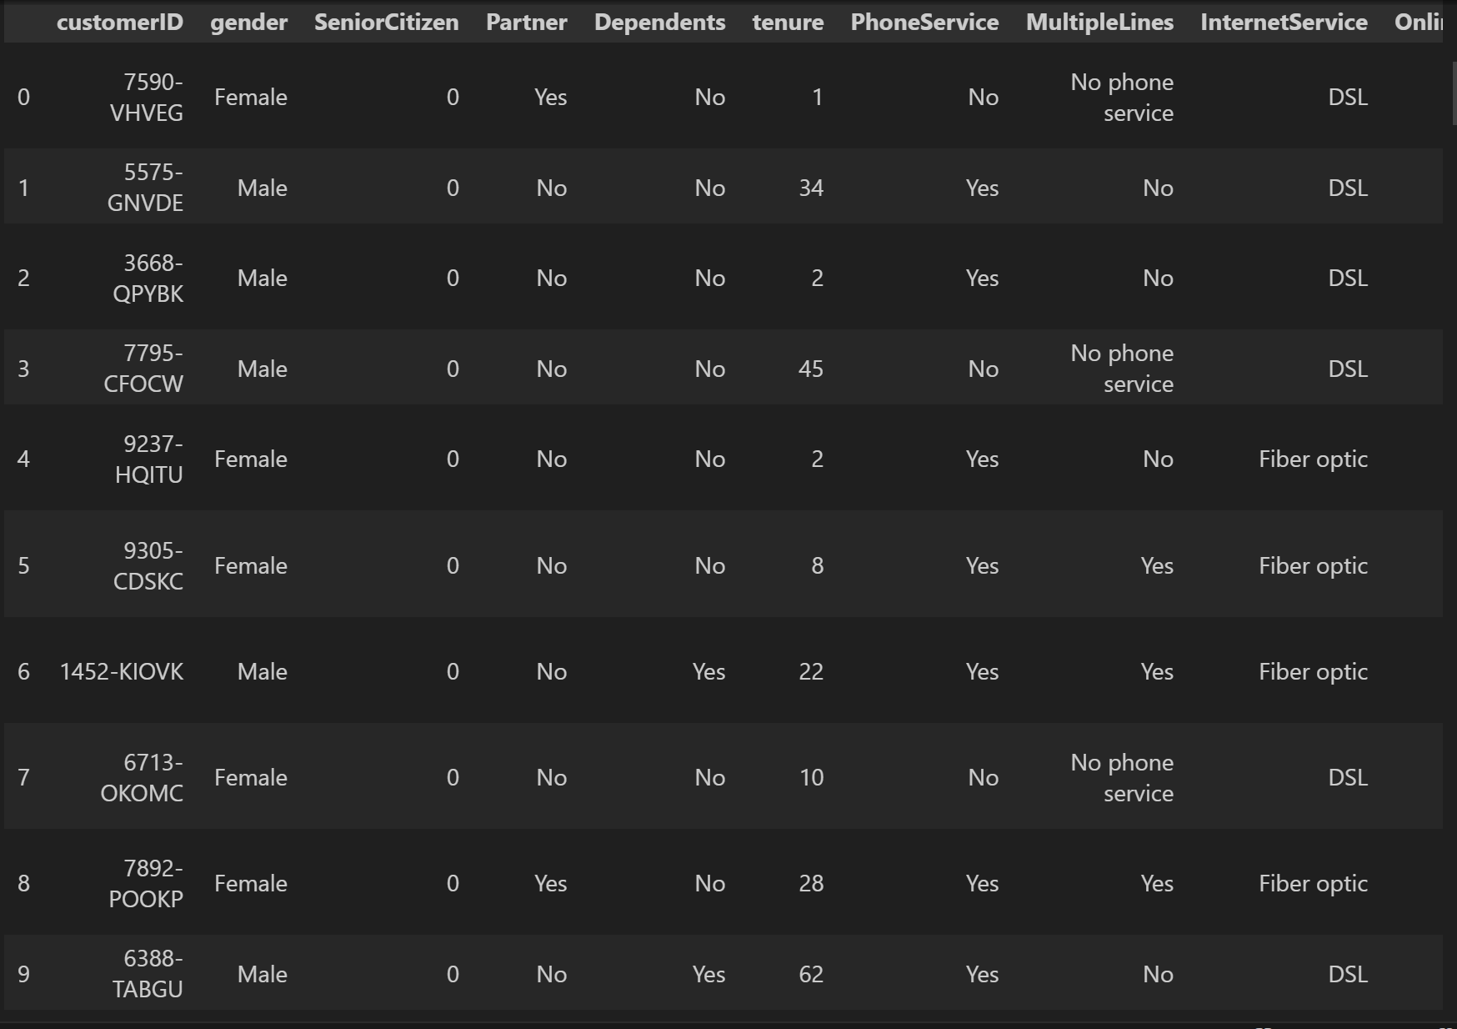
Part A - Data Overview & Preprocessing
Dataset Overview:
Source: Telco Customer Churn Dataset.
Volume: 7,043 Customer records with 21 attributes.
Preprocessing Steps:
Handling Nulls: Converted TotalCharges to numeric; filled missing values with 0.
Encoding: Applied Label Encoding for binary variables (Yes/No) and One-Hot Encoding for multi-class variables (e.g., Payment Method).
Scaling: Standardized tenure, MonthlyCharges, and TotalCharges for model stability

Slide 3
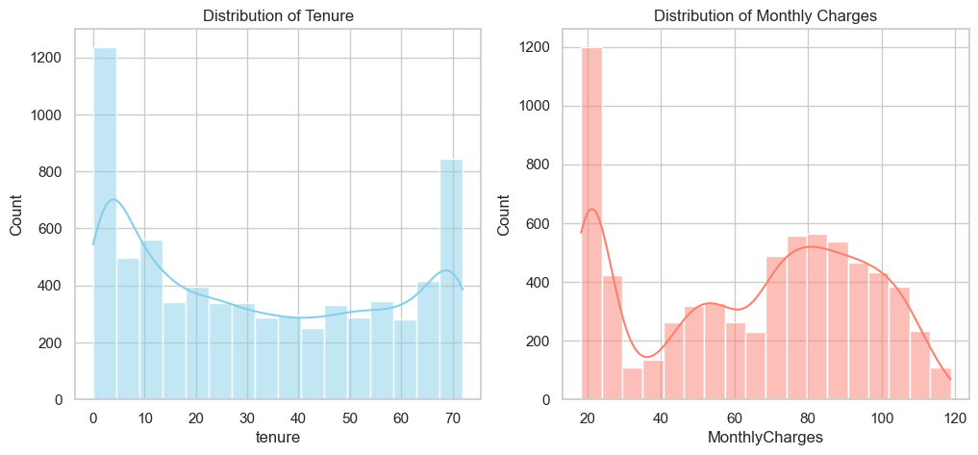
Exploratory Data Analysis (Distributions)
Numerical Summary:
Average Tenure: ~32 months.
Average Monthly Charge: ~$65.
Distributions:
Tenure: Bimodal distribution. A huge spike in new customers (< 5 months) and loyal customers (> 65 months).
Charges: Skewed towards lower monthly charges, but a significant portion pays high rates.

Slide 4
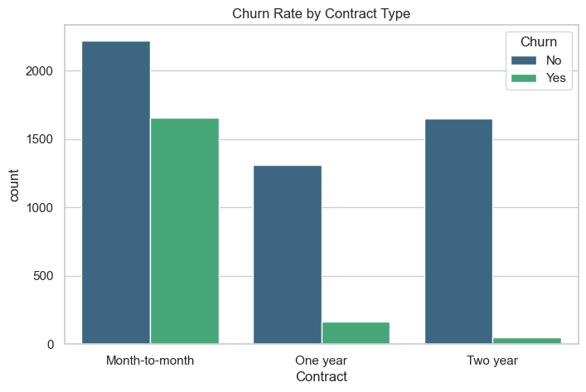
Key Churn Drivers
Contract Type Analysis:
Month-to-month contracts show a drastically higher churn rate compared to One or Two-year contracts.
Long-term contracts act as a strong retention mechanism.

Slide 5
Correlation Analysis
Feature Correlations:
Positive Correlation: Higher MonthlyCharges and PaperlessBilling correlate with Churn.
Negative Correlation: High tenure and Two year contracts correlate with Retention (No Churn).

Slide 6
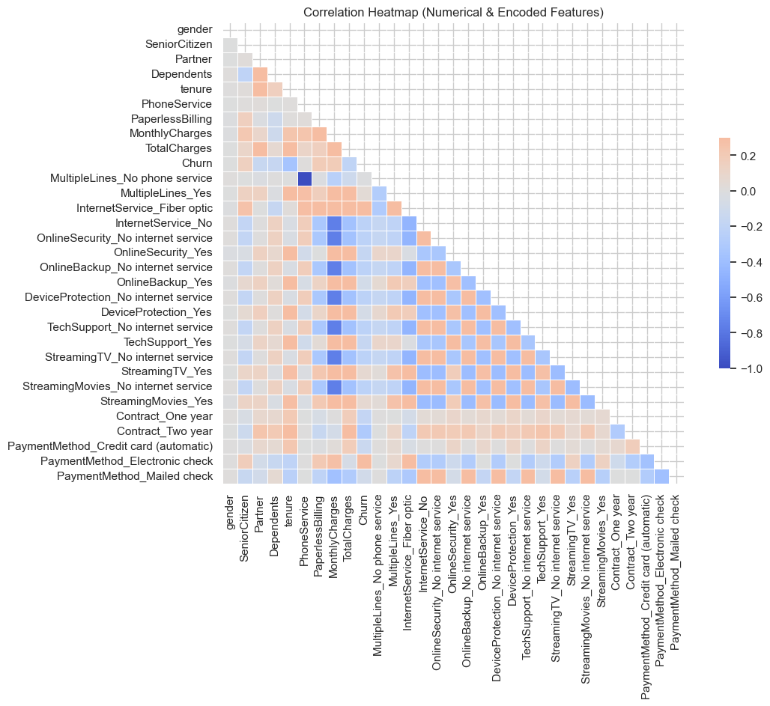
Correlation analysis continued…

Slide 7
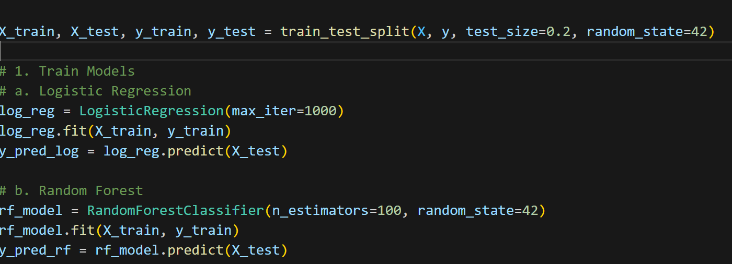
Machine Learning Models
Approach:
Split: 80% Training Data / 20% Testing Data.
Models Trained:
Logistic Regression: Baseline model, highly interpretable.
Random Forest Classifier: Ensemble method to capture non-linear relationships.

Slide 8
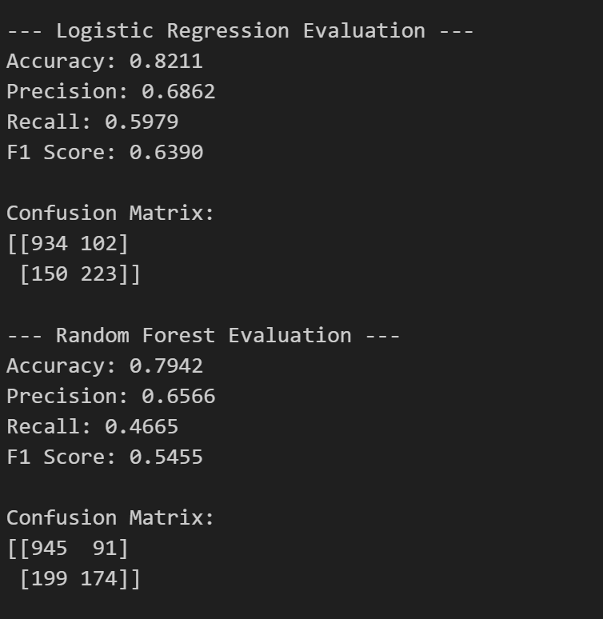
Model Evaluation Results
Comparison:
Logistic Regression:
Accuracy: 82.11%
F1-Score: 0.64
Random Forest:
Accuracy: 79.42%
F1-Score: 0.55
Conclusion: Logistic Regression outperformed Random Forest in this specific iteration, offering better recall and precision balance.

Slide 9
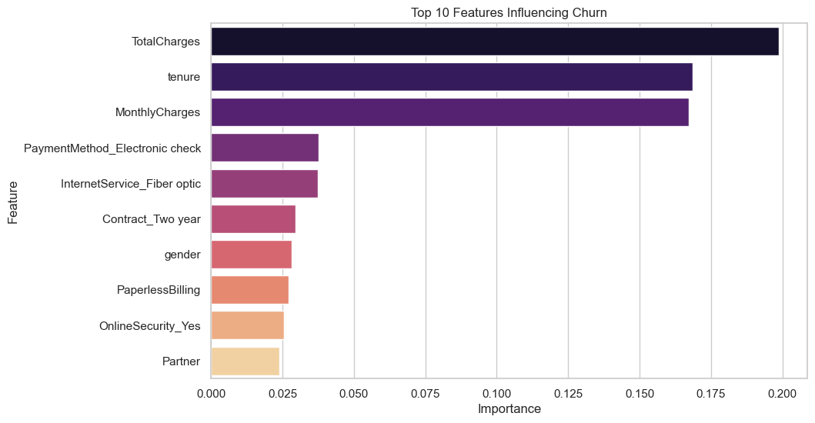
Feature Importance
What Drives Churn? Based on the model analysis, the top factors influencing predictions are:
Total Charges: High lifetime value customers behave differently.
Monthly Charges: Pricing sensitivity is high.
Tenure: New customers are the most volatile.
Contract Type: The strongest behavioral predictor.

Slide 10
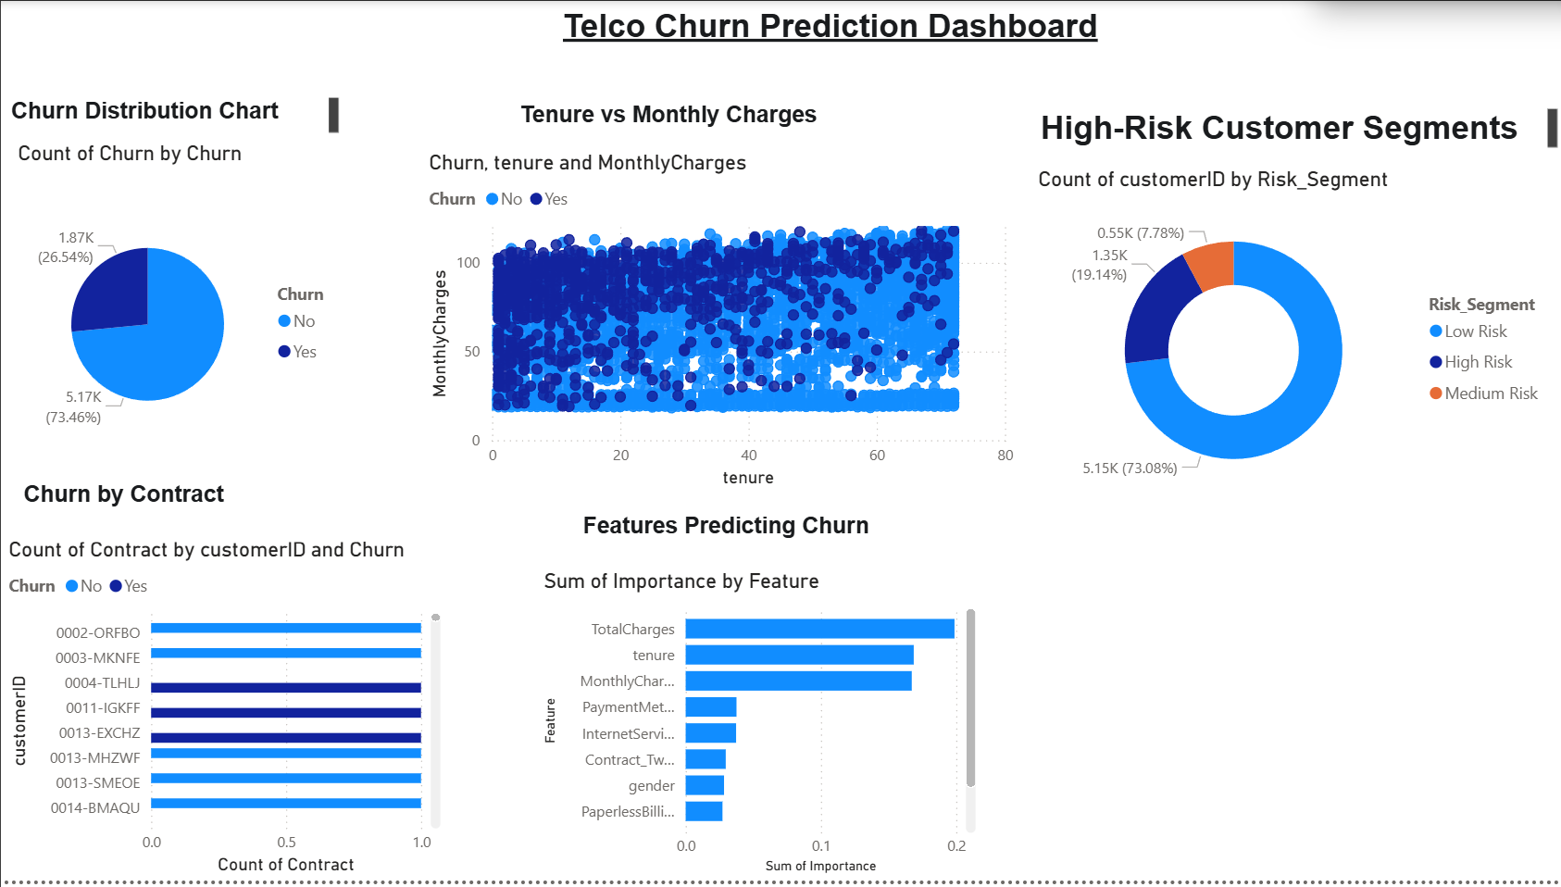
Executive Dashboard Design
Dashboard Concept: A Power BI interface for marketing teams to identify high-risk segments.
Key Components:
Risk Segmentation: Categorizing users into Low, Medium, and High Risk.
Distribution: Visual breakdown of churned vs. active users.
Financial Impact: Analyzing charges vs. tenure.

Slide 11
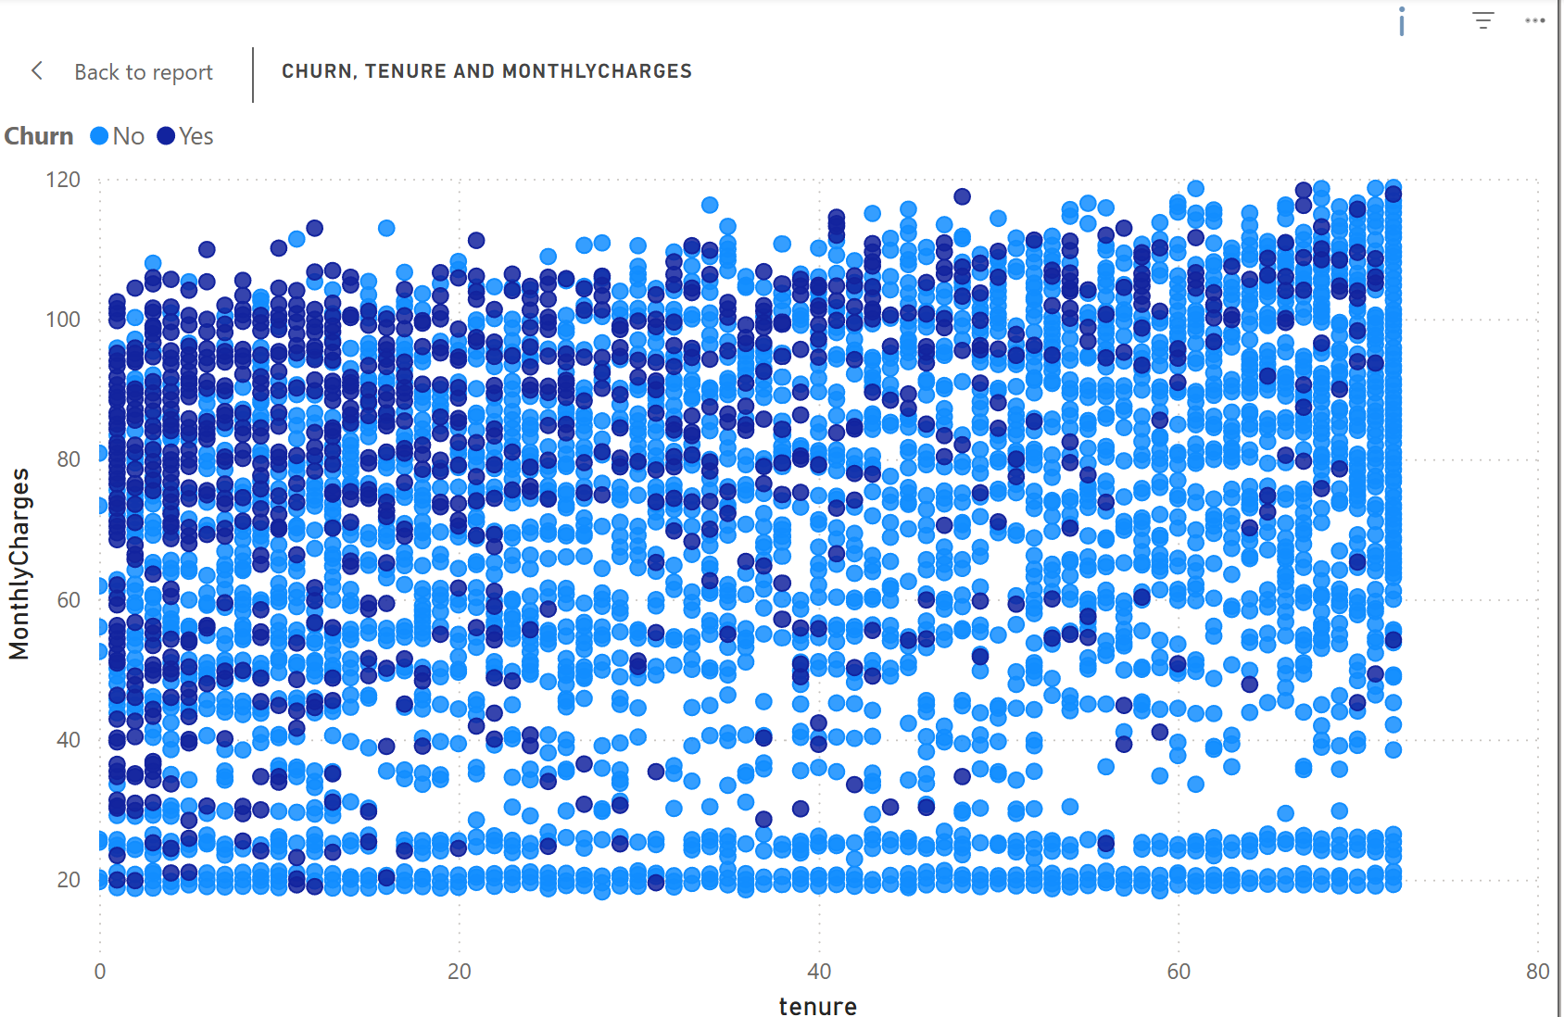
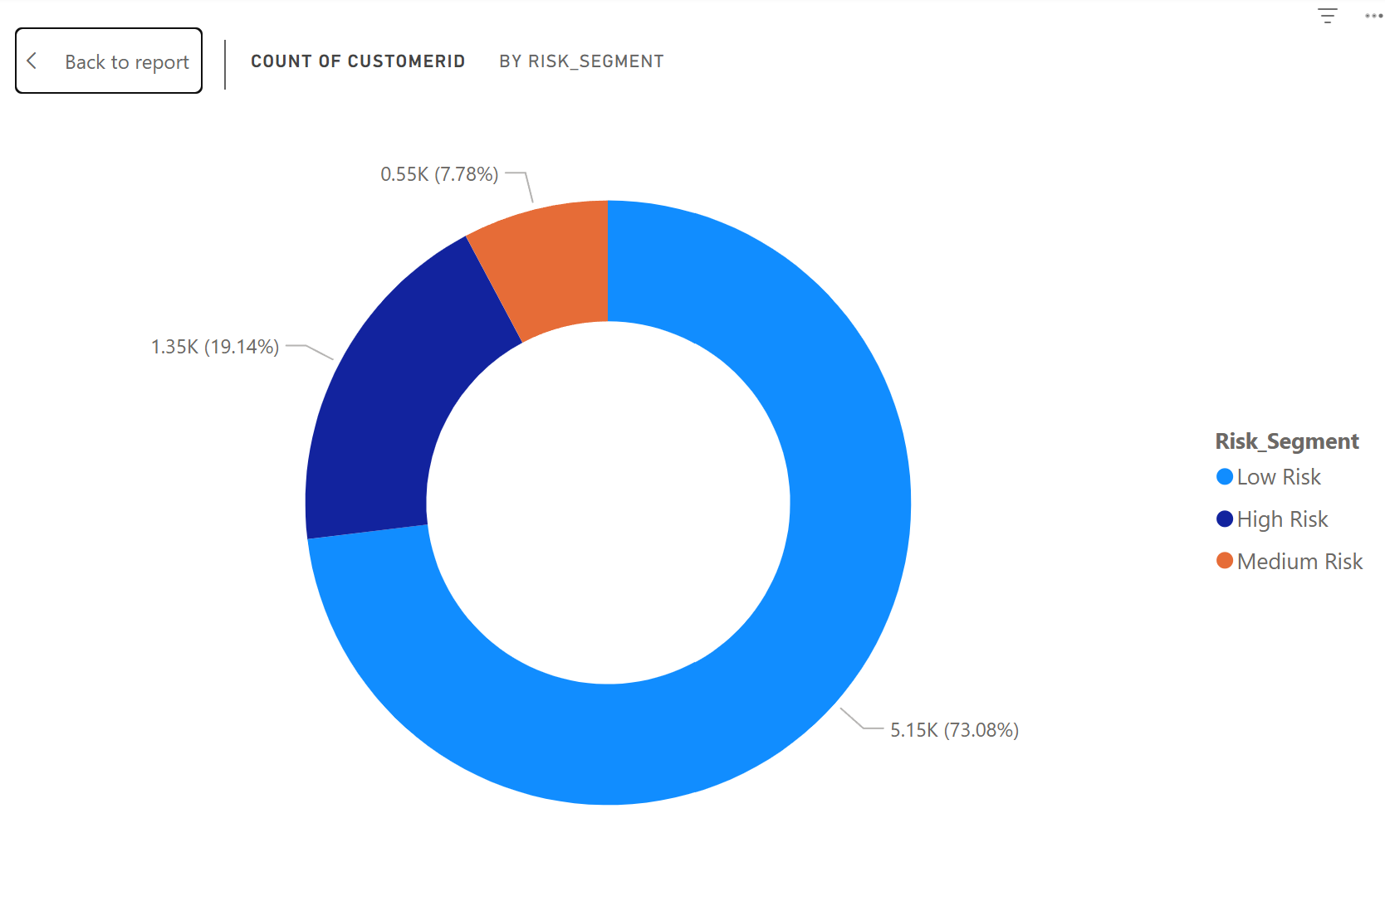
Dashboard Deep Dive (Insights)
Churn Distribution:
Visualizes the overall health of the subscriber base.
Tenure vs. Monthly Charges:
Scatter plot reveals a "Kill Zone": New customers paying high monthly fees churn the fastest.
High-Risk Segment:
Identified via probability scores from the Random Forest model (Probability > 70%).

Slide 12
Recommendations & Conclusion
Strategic Recommendations:
Target the "New & High Paying": Offer discounts or loyalty perks to fiber-optic users in their first 6 months.
Contract Migration: Launch campaigns to move Month-to-Month users to 1-Year contracts (e.g., "Pay for 10 months, get 12").
Digital Payments: Investigate why users with "Electronic Check" payment methods have higher churn (UX friction?).

